Slide 1
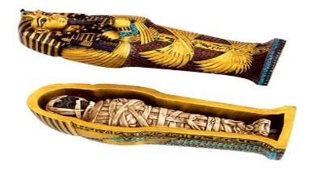
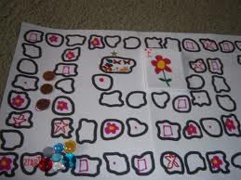
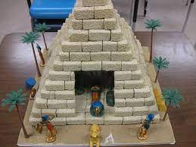
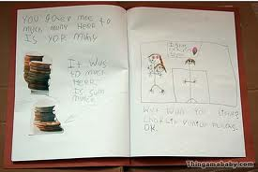
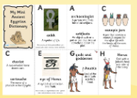
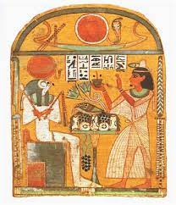
Year 3/4 Homework Grid Autumn 1
All children at Trimley St Mary will receive a homework grid each half term. The function of homework is; to give families a starting point for discussion about what is being learned in school and to give children an opportunity to consolidate and extend their understanding.
Family life is busy and can be unpredictable: some activities will take more time than others. This grid gives you an opportunity to pick activities that suit the time you have available – as a guide please aim for one activity per week.
Daily reading and maths activities should continue be practised – see details at the bottom of the page. For the main homework activity each week, children should select a square of the grid to complete and return to school on a day to suit you. Children will be rewarded for each activity they complete.
Visit a virtual museum - take photos - label and describe what you saw, heard, felt and smelt? | Research what an Ancient Egypt scene might have looked like, then show in pictures, words or a model | Make a simple game about Ancient Egypt e.g. snakes and ladders
Research what life might have been like in Ancient Egypt. Create a fact file about Ancient Egypt. | Create an alphabetical list of Ancient Egyptian artefacts. | Find a picture linked to theme. Write captions. I spy / If I look closely / I wonder why . . / I wonder how . . /I wonder when . .
Purple Mash (times tables)
My Maths
Daily Reading Challenge (five minutes a day)
Learning to spell words in the diary (two a week?)

Slide 2
Year -3/4 Homework Grid Autumn 1
Daily practice of key skills allows children to become more fluent and more confident, and gives them the chance to build on this knowledge. In both reading and maths it has been shown that children who regularly practice skills and complete in a range of contexts are better able to apply these skills in all areas.
Daily Reading
Phonics practice
My Maths

