Slide 1

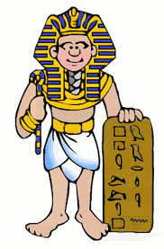
English Recording letters and diary entries in the first person Instruction writing, Mummification Newspaper reports: The discovery of Tutankhamen’s tomb Setting descriptions (Tadeo Jones) Narrative. The story of Egyptian Cinderella) |  | Science – Light The importance of sunshine to grow plants How shadows are formed The changing size of shadows Exploring transparency |  | Maths To use the four operations (+ - X ÷) to solve calculation and reasoning problems. To learn about measurement, shape, co-ordinates, fractions, percentages and decimals. To use weekly Beat Its, CLICs and SAFE for ‘quick fire’ learning and reinforcement.
History To use evidence to ask questions and find answers to questions about life and jobs in Ancient Egyptian times |  | Geography Use mapping skills to identify key locations and climates. Investigate the position and importance of the River Nile |  | Year 2023–Autumn Term Enchanting Egyptians Why did the Egyptians stop building Pyramids? |  | Art Make 3D clay sculptures of canopic jars Create a pattern on cloth with batik which would be worn by an Egyptian |  | Design Technology Create an Egyptian feast.
PSHE Exploring the rules that keep us safe |  | ICT Coding Online safety |  | Music Charanga composition (Y3) Learning an instrument (Y4) |  | PE Invasion games Egyptian dance |  | RE Explore salvation Explore what a rescue looks like and who could be a rescuer.

